Slide 1















Digital Portfolio
STUDENT NAME: s.pavithra
REGISTER NO AND NMID: 30324U09068 and
0504C9E2C0707BE9D9B472D998CDF2A1
DEPARTMENT: BCA
COLLEGE: COLLEGE/ UNIVERSITY: Arcot Sri Mahaalakshmi women’s
college
1

Slide 2

PROJECT TITLE
Inactive digital portfolio
using frontend
developement
2

Slide 3




AGENDA
1.Problem Statement
2.Project Overview
3.End Users
4.Tools and Technologies
5.Portfolio design and Layout
6.Features and Functionality
7.Results and Screenshots
8.Conclusion
9.Github Link
3/21/2024 Annual Review
3

Slide 4

PROBLEM STATEMENT
In the modern digital world, resumes and
CVs are no longer enough to represent
the true capabilities of a student or
professional.Recruiters prefer interactive
portfolios that give a real sense of
creativity, skills, and projects.
4

Slide 5
Lack of a professional portfolio leads to:Missed
opportunities in placements or
interviews.Difficulty in showcasing practical
projects and coding abilities.Limited personal
branding.Problem Defined: There is a gap
between talent and presentation. A personal
portfolio website bridges this gap by offering a
24/7 accessible online platform to showcase
skills.

Slide 6

PROJECT OVERVIEW
The project is a web-based personal
portfolio created using front-end
technologies.It acts as a digital
identity for the individual.Includes
different sections like: About Me,
Education, Skills, Projects,
Achievements, and Contact
Information.
6

Slide 7
Designed to be responsive, lightweight,
and user-friendly.Objective: To help
individuals establish a professional online
presence, make networking easier, and
improve job-seeking chances.Scope: Can
be extended with advanced features like
blogs, dark mode, or AI-powered resume
analysis.

Slide 8

WHO ARE THE END USERS?
1. Students – To highlight
academic progress and
personal projects.
2. 2. Job Seekers – To share
portfolios with employers
instead of traditional resumes.
3. 3. Recruiters – To quickly
assess skills and projects
before interviews.
8

Slide 9
4. Teachers & Mentors – To
monitor technical growth of
students.
5. Freelancers & Creators – To
attract clients by showcasing work.
6. General Public/Peers – For
networking and collaboration
opportunities.

Slide 10

TOOLS AND TECHNIQUES
HTML (HyperText Markup
Language): Structure of the
website.CSS (Cascading Style
Sheets): Styling, colors, fonts, and
layout.JavaScript: Interactivity
(animations, navigation menus,
effects).VS Code: Integrated
Development Environment (IDE)
for coding.Git & GitHub: Version
control, collaboration, and
deployment.
1
0

Slide 11
Canva/Figma: To design
portfolio layout and
mockups.Hosting Platforms:
GitHub Pages, Netlify, or Vercel
for deployment.(Optional
Advanced Add-
ons)Bootstrap/Tailwind CSS:
For faster UI design.React.js: To
convert into a dynamic,
modern portfolio.

Slide 12
POTFOLIO DESIGN AND LAYOUT
Homepage: Attractive banner, your
photo/logo, and tagline (e.g., “Aspiring
Web Developer | Programmer |
Learner”).
About Me Section: Education details,
background, passion, and career goals.
Skills Section: Programming languages
(Python, C++, Java), tools (Git, VS Code),
and frameworks.
12

Slide 13
Projects Section:Academic mini projects.Personal coding
projects with GitHub links.Screenshots for clarity.
Achievements Section: Certifications, competition
participation, hackathons, sports achievements (e.g., district-
level hockey).
Hobbies Section: Reading, dancing, singing – to show personal
creativity.Contact Section: Email, phone, social media links, and
GitHub repository.

Slide 14
FEATURES AND FUNCTIONALITY
Responsive Design: Works on desktop, tablet, and mobile
devices.
Interactive Navigation: Smooth scroll, sticky menu, animated
buttons.
Project Links: Clickable GitHub links to explore code.
Contact Form: Direct message option via email.
Animations: Fade-in, hover effects, image transitions.

Slide 15
Lightweight & Fast: Optimized code for quick loading.
Customization: Easy to update anytime with new skills or projects.
Future Enhancements:Dark/Light theme toggle.AI chatbot
introduction.
Blog section for knowledge sharing.

Slide 16

RESULTS AND SCREENSHOTS
Successfully created a portfolio website
with all necessary sections.Hosted the
portfolio live on GitHub
Pages.Screenshots:Homepage view (intro
+ navigation).Skills page showing progress
bars/skill charts.Projects page with
clickable links.Contact form working
successfully.Performance: Website loads
within 3–5 seconds, tested on multiple
devices.Positive feedback from peers,
mentors, and recruiters.
3/21/2024 Annual Review
16

Slide 17
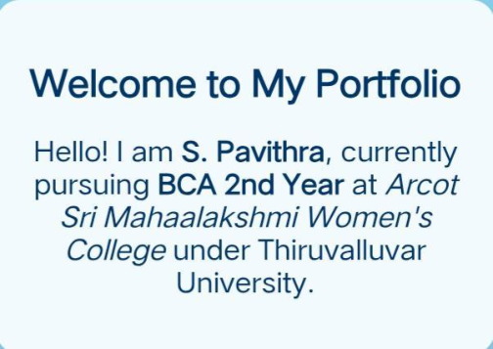
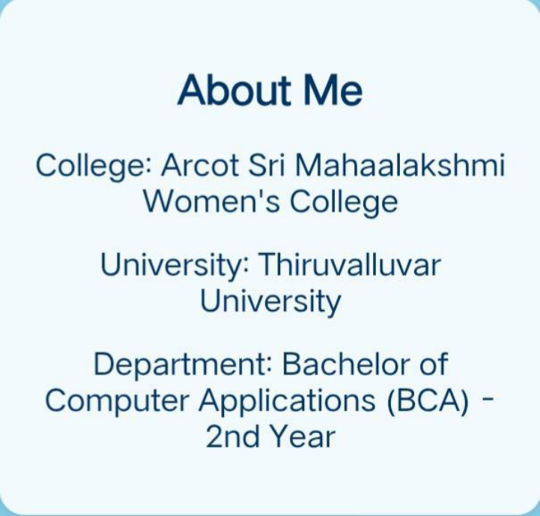
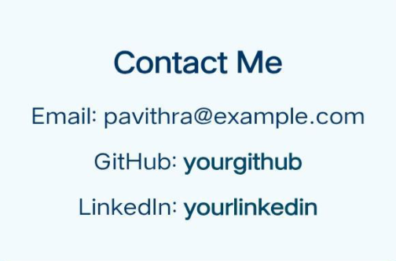

Slide 18
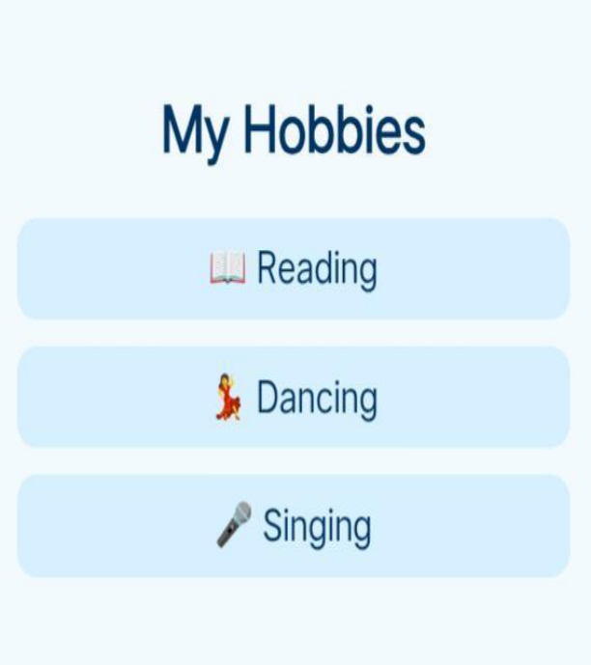
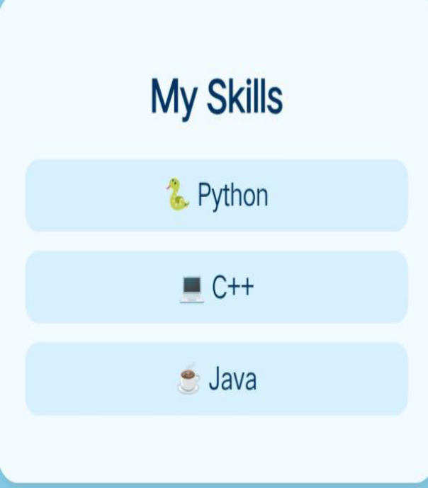

Slide 19
CONCLUSION
The project highlights creativity, technical
knowledge, and self-presentation
skills.Demonstrates the ability to build a real-
world application using HTML, CSS, and
JavaScript.Portfolio websites are essential
for:Personal branding.Academic &
professional growth.Opportunities in
placements, internships, and freelancing.This
portfolio acts as a stepping stone for
advanced projects (like full-stack
websites).Concludes that a portfolio is not
just a project, but a digital identity.
19

Slide 20
GITHUB LINK
https://pavithra22122006.github.io/Pavithra/

